Slide 1
MFE Python Course
Productionization, Part 1

Slide 2
Course Progress Overview
✅ learned python
✅ built features
✅ trained model
[ ] deployed model
Today we bridge the gap between research and production code
Key transition: Moving from exploratory analysis to reliable systems
Final assignment preview: Building a production-grade model serving endpoint

Slide 3
Agenda
Debugging
Linting
Testing
Web frameworks
Containers

Slide 4
The Cost of Poor Production Practices
Knight Capital's $440M Loss in 45 Minutes
- Aug 1, 2012: New trading algorithm deployed to production
- Code reused old "Power Peg" flag accidentally left in codebase
- Deployment skipped testing on 1 of 8 servers
- Result: 4 million unintended trades in 45 minutes
Key Lessons:
- Seemingly minor deployment issues can cascade catastrophically
- Missing tests and quality checks have real financial impact
- Production systems need rigorous deployment processes
- Financial markets punish technical mistakes severely

Slide 5
From Research to Production
Jupyter Notebooks: Great for Research, Risky for Production
Benefits of Notebooks:
- Quick experimentation and visualization
- Interactive debugging and data exploration
- Great for presentations and documentation
- Easy to share research findings
Why They're Not Production-Ready:
- Hidden state and non-linear execution
- Poor version control and code review
- No proper error handling or logging
- Hard to test and maintain
Production Code Requirements:
- Modular, reusable functions
- Proper exception handling
- Automated testing
- Consistent style and documentation
- Reproducible builds

Slide 6
Core Requirements for Production ML
Reliability
- Consistent model performance
- Graceful error handling
- Data validation
Scalability
- Handle varying load
- Resource efficiency
- Quick deployment
Maintainability
- Clear code structure
- Documentation
- Version control
Monitoring
- Performance metrics
- Model drift detection
- System health

Slide 7
Debugging Fundamentals

Slide 8
The Purpose of Debugging
Beyond Just Fixing Bugs:
- Understanding code behavior is as important as fixing issues
- Debugging is a crucial skill for technical interviews
Proactive Debugging:
- Code reviews and testing catch issues early
- Logging and monitoring prevent production failures
Reactive Debugging:
- Systematic approach to solving production issues
- Focus on root causes, not just symptoms

Slide 9
Common ML Debugging Scenarios
Data Pipeline Issues:
- Missing or corrupted data
- Incorrect preprocessing steps
- Data type mismatches
- Unexpected outliers/nulls
Model Behavior:
- Prediction anomalies
- Performance degradation
- Training instability
- Resource usage spikes
Common in Finance:
- Market data inconsistencies
- Stale prices in real-time feeds
- Incorrect adjustment for corporate actions
- Missing dividend data affecting returns
- Risk calculation errors
- VaR calculations using wrong time window
- Greeks computed with stale volatility surface
- Correlation matrix not positive definite
- Portfolio rebalancing issues
- Position reconciliation mismatches
- Wrong FX rates for international securities
- Trading volume constraints violated
- Time-sensitive failures
- Market open/close timing bugs
- Options expiry date calculations
- Settlement date processing errors

Slide 10
Key Steps in Systematic Debugging
1. Observe & Document
• Log exact error messages
• Note system state
• Record reproduction steps
3. Hypothesize & Test
• Form theories
• Write targeted tests
• Validate assumptions
2. Reproduce & Isolate
• Create minimal example
• Control variables
• Identify patterns
4. Fix & Verify
• Implement solution
• Add regression tests
• Monitor in production

Slide 11
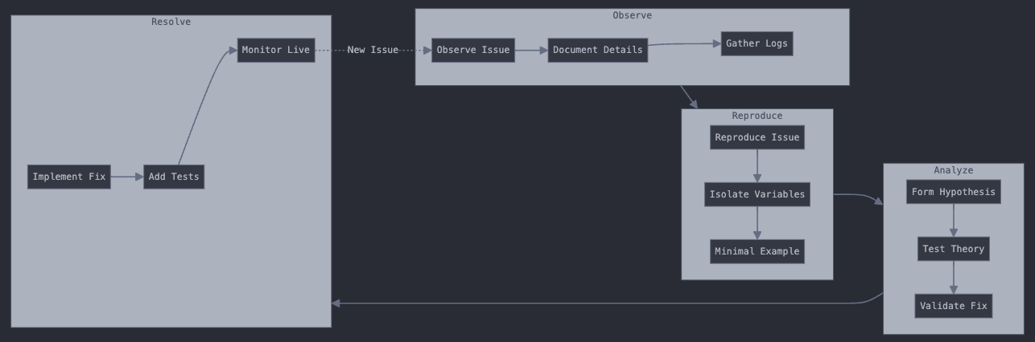

Slide 12
Debugging Tools
1. Print Statements
- Quick but messy
- Limited context
- Hard to maintain
3. Interactive Debuggers
- Step-through execution
- Variable inspection
- Breakpoint control
2. Logging
- Structured output
- Different log levels
- Persistent records
4. Modern Tools
- IDE integration
- Performance profilers
- Memory analyzers

Slide 13
Code Quality & Linting

Slide 14
Why Code Quality Matters
Cost of Poor Quality
- 42% of developer time spent maintaining legacy code
- 2.5x longer to onboard new team members
- Higher risk of production incidents
Financial Industry Stakes
- Regulatory compliance requirements
- Audit trail importance
- Multi-team code dependencies
- High cost of errors
Team Benefits
- Faster code reviews
- Easier debugging
- Better knowledge sharing
- Reduced technical debt

Slide 15
What is Linting
Definition
- Automated code analysis tool
- Flags programming and stylistic errors
- Enforces consistent coding standards
- Named after Unix "lint" tool
What Linters Check:
- Syntax errors
- Variable naming
- Code complexity
- Unused imports
- Style guide violations
Why We Lint:
- Catch errors before runtime
- Enforce team standards automatically
- Reduce code review friction
- Improve code maintainability
When to Lint:
- During development (IDE integration)
- Pre-commit hooks
- Continuous Integration
- Before code review

Slide 16
Linting Tools - Essential Stack
flake8
- Style guide enforcement
- Syntax error detection
- Complexity checks
- Custom rule support
black
- Automatic code formatting
- Non-negotiable style
- Git-friendly
- Team consistency
isort
- Import organization
- Module grouping
- Dependency clarity
- Standardized layout
mypy
- Static type checking
- Runtime error prevention
- Better IDE support
- Self-documenting code

Slide 17
Testing

Slide 18
Why We Test
Testing in Financial Systems:
1. Risk Mitigation
- Prevent costly production errors
- Validate business logic
- Ensure numerical accuracy
2. Quality Assurance
- Maintain code reliability
- Verify model behavior
- Protect critical functionality
3. Team Confidence
- Safe refactoring
- Faster deployments
- Clear documentation
Expectations of Quants:
- Write tests before implementing complex financial calculations
- Validate against known edge cases (e.g., market stress scenarios)
- Document test cases with clear financial interpretation
- Test numerical precision and floating-point behavior
- Verify model behavior across different market regimes
- Include regulatory compliance checks in test suites

Slide 19
Testing Throughout the Stack
1. Local Development
- Unit tests
- Quick feedback
- Development validation
3. Staging
- Production-like testing
- Load testing
- Data validation
2. Continuous Integration
- Full test suite
- Integration checks
- Performance tests
4. Production
- Smoke tests
- Monitoring
- A/B testing

Slide 20
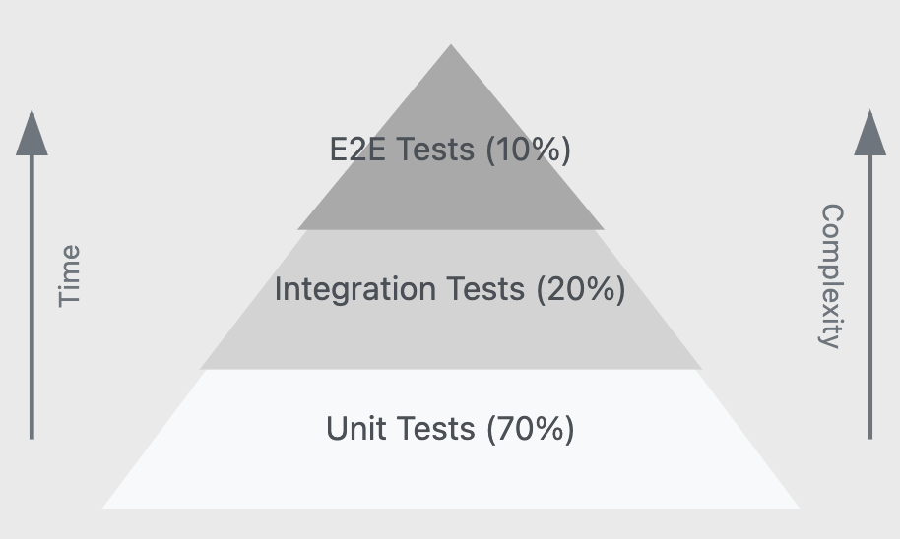
Testing Throughout the Stack
Test Distribution Explained:
- 70% Unit Tests: The majority of your tests should be unit tests that verify individual components in isolation. These are fast, reliable, and help pinpoint issues quickly.
- 20% Integration Tests: A smaller portion should test how components work together, like checking if your data pipeline properly feeds into your model.
- 10% End-to-End Tests: The smallest portion should be comprehensive tests that verify entire workflows, as these are the most time-consuming and complex to maintain.
This ratio helps teams balance between comprehensive testing and development velocity.

Slide 21
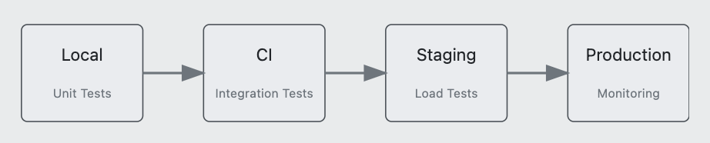
Testing Throughout the Stack

Slide 22
Stages of Testing
Testing ML Components:
Data Preprocessing
- Input validation
- Feature engineering
- Data transformations
- Edge cases
Model Components
- Layer configurations
- Custom loss functions
- Optimization settings
- Numerical stability
Prediction Logic
- Output formats
- Inference pipeline
- Performance constraints
- Error handling
Testing System Interactions:
Data Pipeline Integration
- Data source connections
- ETL processes
- Data quality checks
- Storage systems
Model Training Pipeline
- Feature pipeline
- Training workflow
- Model serialization
- Version control
Inference Pipeline
- API endpoints
- Batch processing
- Real-time scoring
- Error recovery
Full System Validation:
System Tests
- Complete workflows
- Business requirements
- Cross-component interaction
- Error scenarios
Performance Tests
- Response times
- Resource usage
- Concurrent users
- Data throughput
Load Tests
- Peak capacity
- Failure points
- Recovery behavior
- SLA validation
Unit tests
(local)
Integration tests
(CI/CD)
End-to-end tests
(staging)

Slide 23
Unit Test Fundamentals
Test Coverage
Your tests should cover all critical paths through your code, not just the happy path. Aim for at least 80% coverage in financial applications, with complete coverage of risk calculations and trade processing logic. Coverage tools help identify untested code, but focusing solely on coverage metrics can be misleading.
Test Reproducibility
Tests must produce the same results every time they run, regardless of environment or timing. Seed random number generators, mock time-dependent functions, and avoid dependencies on external state. This is especially crucial for financial models that use stochastic processes or market data.
Test Independence
Each test should be completely isolated and self-contained. Tests should never depend on the results of other tests or share mutable state. Reset any shared resources (like database connections or global variables) between test runs to prevent cross-contamination.

Slide 24
Unit Test Fundamentals
Test Determinism
Tests should never have timing dependencies or race conditions. When testing time-sensitive operations like options pricing or settlement calculations, explicitly control the time context rather than relying on the system clock.
Positive vs Negative Testing
Positive Tests: Verify that your code works correctly under expected conditions (e.g., calculating Greeks for standard option contracts).
Negative Tests: Ensure your code fails gracefully under invalid conditions (e.g., handling malformed trade data or invalid market quotes).
Test Isolation
Mock external dependencies (APIs, databases, file systems) to ensure tests only validate the specific unit of code being tested. For financial applications, this often means creating synthetic market data and mock trading systems.

Slide 25
Pytest Fundamentals and Industry Standards
Test Structure
Each unit test should focus on a single functionality and follow the Arrange-Act-Assert pattern: set up the test conditions, execute the function under test, and verify the results match expectations. Break complex tests into multiple focused test cases.
Naming and Organization
Structure test files to mirror your production code's organization, prefixing files with 'test_'. Name test functions descriptively to clearly indicate the scenario being tested, such as 'test_portfolio_rebalance_handles_negative_weights'.
Test Data Management
Create reusable test fixtures using pytest.fixture to maintain consistent test data across multiple test cases. For financial data, include edge cases like market holidays, corporate actions, and extreme market conditions in your test datasets.
Assertions and Validation
Use pytest's built-in assert statements along with numpy.testing for numerical comparisons, being mindful of floating-point precision in financial calculations. Include appropriate tolerance levels when comparing floating-point results.

Slide 26
Pytest Fundamentals and Industry Standards
Mocking and Dependencies
Utilize pytest's monkeypatch or unittest.mock to isolate the code under test from external dependencies like market data feeds or databases. Create mock objects that accurately represent the behavior of your production systems.
Error Testing
Explicitly test error conditions using pytest.raises to verify that your code handles exceptions appropriately, especially for critical scenarios like invalid trades or data inconsistencies that could lead to financial losses.
Documentation and Maintenance
Include docstrings in test functions to explain the business context and importance of each test case. Regularly review and update tests when business requirements or market conditions change.

Slide 27
Web Frameworks

Slide 28
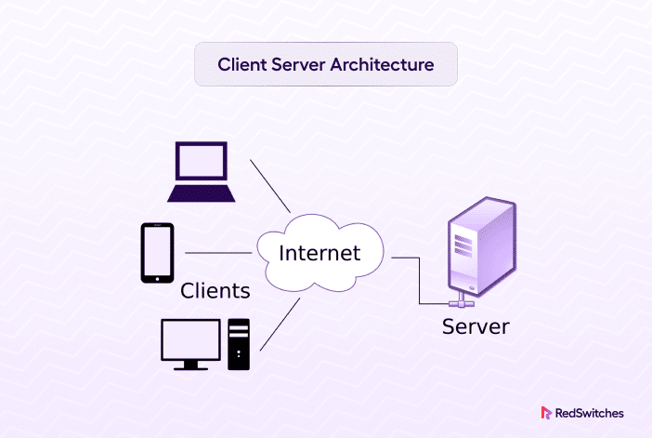
Web Services Fundamentals
Client-Server Basics
- Client: Makes requests (e.g., trading interface)
- Server: Processes and responds (e.g., model service)
- Protocol: HTTP defines how they communicate
- API: Interface for programmatic interaction
Key Advantages
- Scalable architecture
- Language-agnostic
- Microservice friendly
- Easy to monitor

Slide 29
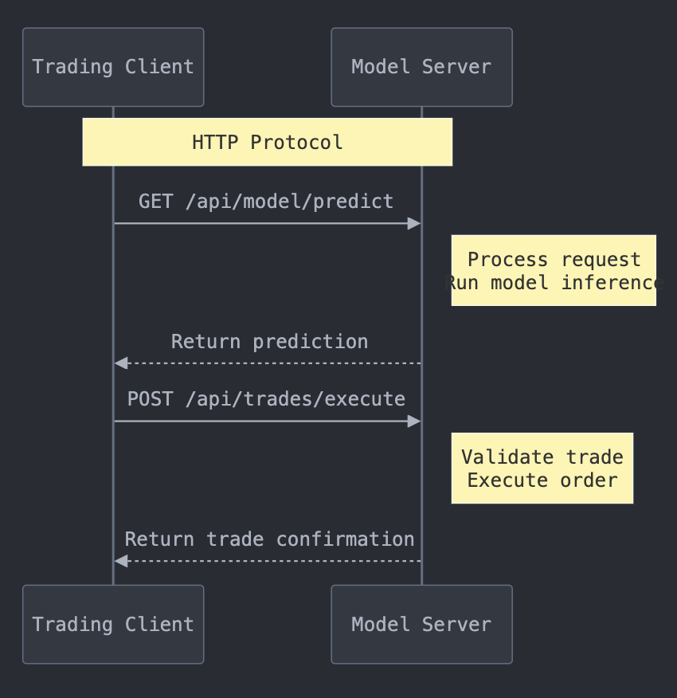
Client-Server Architecture

Slide 30
REST APIs
REST Architecture
- Representational State Transfer
- Standard way to structure web APIs
- Resources identified by URLs
- Uses HTTP methods meaningfully
Best Practices
- Use nouns for resources (/trades not /execute-trade)
- Versioning in URL (/v1/trades)
- Clear status codes (200 OK, 400 Bad Request)
- Consistent error formats
HTTP Methods
GET: Retrieve data (e.g., get portfolio value)
POST: Create new resource (e.g., submit trade)
PUT: Update existing resource (e.g., modify order)
DELETE: Remove resource (e.g., cancel trade)

Slide 31
REST APIs
HTTP Methods
GET: Retrieve data (e.g., get portfolio value)
POST: Create new resource (e.g., submit trade)
PUT: Update existing resource (e.g., modify order)
DELETE: Remove resource (e.g., cancel trade)
CRUD Methods
CREATE: Create new resource (e.g., submit trade)
RETRIEVE: Retrieve data (e.g., get portfolio value)
UPDATE: Update existing resource (e.g., modify order)
DELETE: Remove resource (e.g., cancel trade)

Slide 32
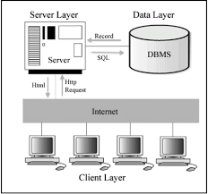
Client-Server Architecture

Slide 33
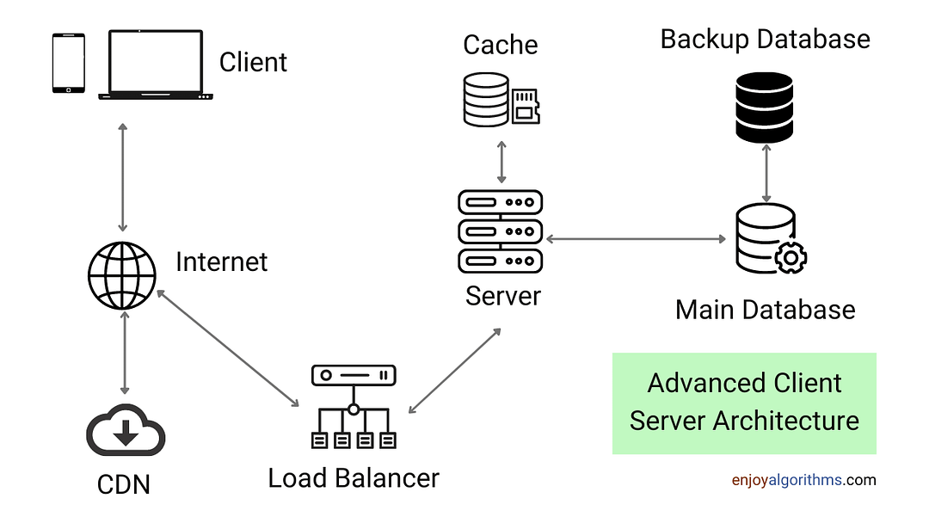
Client-Server Architecture

Slide 34


Slide 35
FastAPI - Python Web Framework
Advantages for Quant Applications
Speed
- High-performance ASGI framework
- Async support for concurrent requests
- Critical for real-time trading systems
Developer Experience
- Modern Python features (type hints)
- Automatic OpenAPI documentation
- Built-in request validation
- IDE support with type checking
ML-Friendly
- Native Pydantic integration
- Easy numpy/pandas handling
- Background task support
- Efficient binary data handling

Slide 36
Request-Response Cycle
1. Request Validation
- Type checking of inputs
- Data format verification
- Business rule validation
- Security checks
3. Response Formatting
- Consistent JSON structure
- Error standardization
- Status codes
- Performance metrics
2. Data Processing
- Input normalization
- Feature engineering
- Batch processing
- Async operations
4. Error Handling
- Graceful degradation
- Informative messages
- Proper logging
- Monitoring alerts

Slide 37
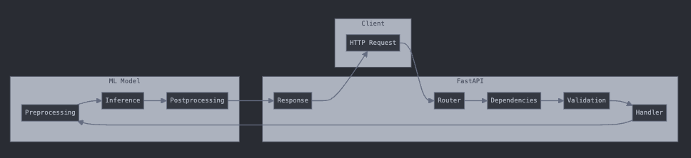
Request-Response Cycle

Slide 38
FastAPI Best Practices
Type Safety
- Use Pydantic models for all I/O
- Define clear request/response schemas
- Leverage type hints throughout
- Enable mypy checking
Path Operations
- Organize routes logically
- Use appropriate HTTP methods
- Include response models
- Document edge cases
Request Handling
- Validate all inputs
- Use dependency injection
- Handle timeouts properly
- Rate limit when needed
Model Serving
- Load models efficiently
- Cache when appropriate
- Monitor inference times
- Version control models

Slide 39
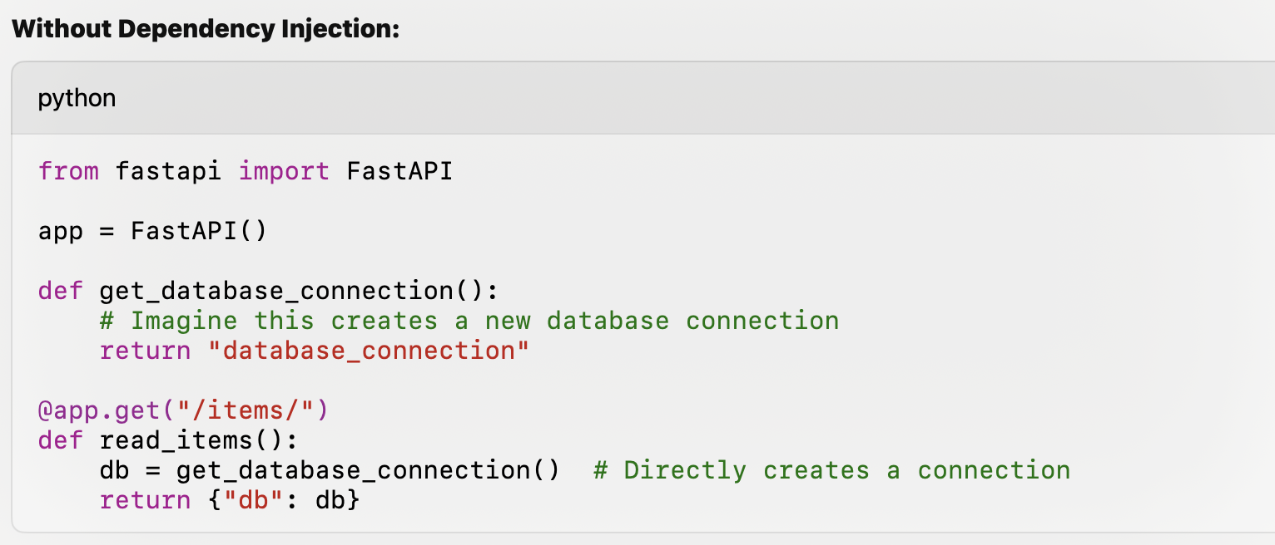
FastAPI Best Practices

Slide 40
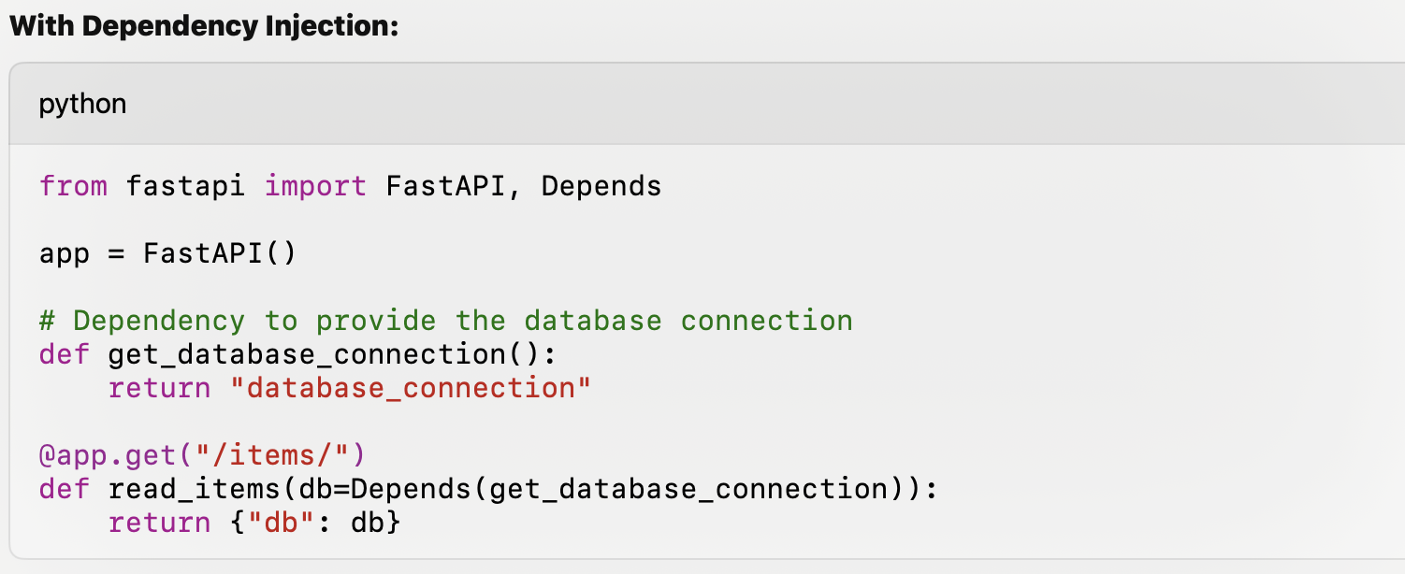
FastAPI Best Practices

Slide 41
ML Model Serving - Deployment Considerations
Model Management
- Version control of models
- A/B testing support
- Model warmup
- Resource optimization
Request Processing
- Input validation
- Batch inference
- Timeout handling
- Error recovery
System Design
- Horizontal scaling
- Load balancing
- Health checks
- Performance monitoring
Common Pitfalls
- Memory leaks from large models
- Slow cold starts
- GIL limitations
- Resource contention

Slide 42
Containers

Slide 43
Why Containers
Development Benefits
- Consistent environments across team
- "Works on my machine" problem solved
- Fast onboarding of new team members
- Easy local testing of production code
Operational Benefits
- Predictable deployments
- Resource isolation
- Fast scaling
- Disaster recovery
Financial Industry Context
- Regulatory compliance through immutable infrastructure
- Reproducible model deployments
- Consistent backtest environments
- Isolated trading systems

Slide 44
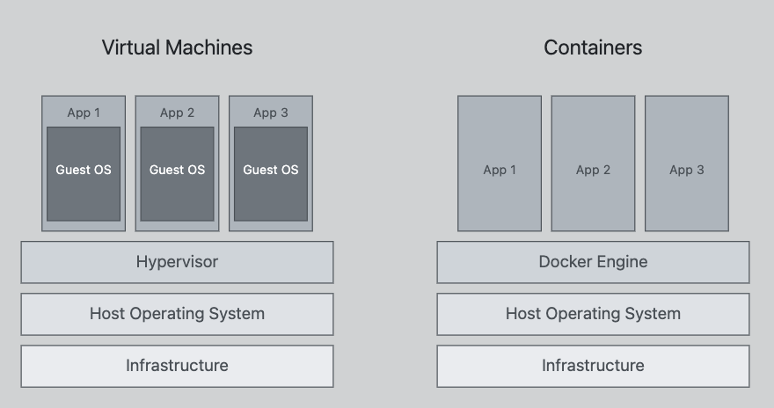
Container Basics
What is a Container?
- Lightweight, standalone package
- Contains everything needed to run code
- Shares OS kernel but isolated processes
- Starts in seconds, minimal overhead
Key Benefits vs VMs
- Smaller footprint (MBs vs GBs)
- Faster startup time
- Better resource utilization
- Easier version control

Slide 45
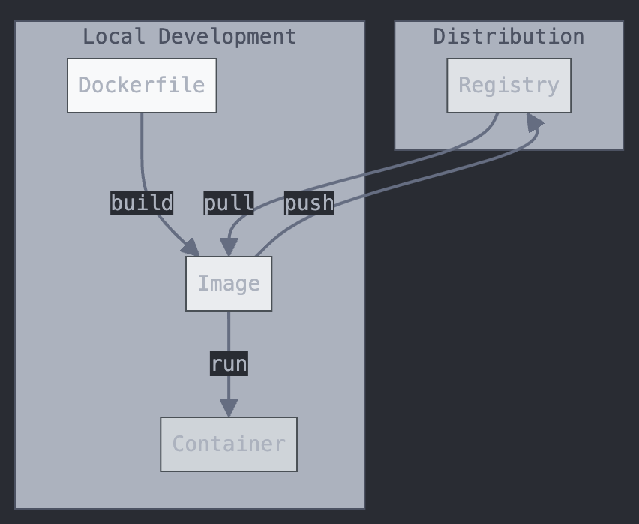
Docker Components
Images
- Blueprint for containers
- Layered file system
- Versioned with tags
- Immutable snapshots
Containers
- Running instance of image
- Isolated process space
- Defined resource limits
- Ephemeral by design
Registry
- Storage for images
- Version control
- Access management
- Distribution system

Slide 46
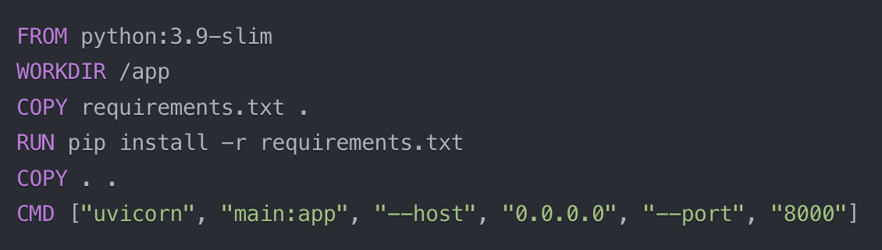
Dockerfile - Defining & Building Images
Key Components
- Base image selection
- Environment setup
- Dependency installation
- Application code
- Runtime configuration
Common Instructions
FROM: Base image
WORKDIR: Set working directory
COPY: Add local files
RUN: Execute commands
CMD: Default command
ENV: Environment variables
Layer Optimization
- Combine related commands
- Clean up after installations
- Use .dockerignore
- Minimize image size
Name file Dockerfile
Place Dockerfile in the root directory of your project
Build image: docker build -t <image_name> .
Run container:
docker run -p <host_port>:<container_port> <image_name>
Stop container: docker stop <container_id_or_name>

Slide 47
Makefile

Slide 48
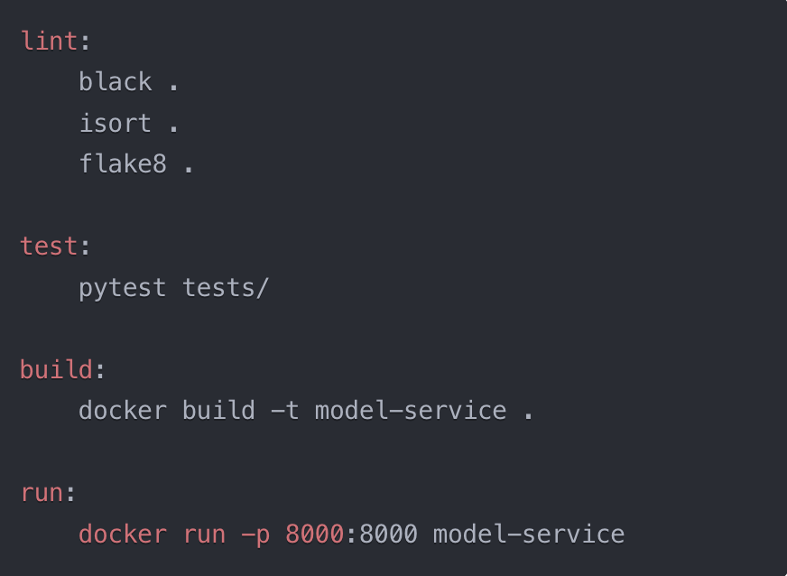
Why Makefiles?
Command automation
Build process standardization
Team consistency
CI/CD integration
How to use:
Name of file: Makefile
  Makefile.dev
  Makefile.prod
Place Makefile in the root directory of your project
Call make lint instead of black ., isort ., flake8 .

Slide 49
Final HW Assignment

Slide 50
Final HW
Serve your model through a containerized service
Create an inference endpoint with FastAPI
Write unit tests for your inference service
Lint your code
Add a makefile with commands that simplify linting and docker
Build an image for your FastAPI service with Docker
Run image locally and test that the inference endpoint works
Use Postman to test the endpoint locally or make a curl request through your terminal.

Slide 51
Common Repo Structure
/
app.py
tests
  test_app.py
Makefile
Dockerfile
requirements.txt

